Slide 1
Social Network Analysis Class (Spring 2019) Jieun Shin
Introduction
1) Introduction
2) Overview of Social Network Analysis
3) Network Data Collection & Basic Measures
4) Personal/Ego-centric Methods
Measures & Methods
5) Fundamental Network Concepts 1 (Centrality)
6) Fundamental Network Concepts 2 (Groups)
7) Fundamental Network Concepts 3 (Positions)
8) Network Level Measures
9) Network Inferential Statistics (QAP & ERGM)
Applications
10) Diffusion & Innovations
11) Digital Media & Network
12) Presentation
13) Presentation
14) Final Project

Slide 2
Week 8: Network Level Indicators
Bird’s eye view of network
There are many network level measures
Size, density, reciprocity, transitivity, average path length, clustering, centralization, and core-periphery

Slide 3
Why Study Network Level Metrics
Interesting
Network indicators affect behavior
Are centralized organizations more efficient?
Does clustering affects behavior spread?
More than one networks can be used to compare processes across conditions
Do behaviors spread more rapidly in dense networks

Slide 4
List of Network Indicators
Size
Density
Number of Components
Percent in largest component
Reciprocity %
Triadic Census
% Transitive triads
Average Path Length
Diameter
Cohesion
Clustering
Core-periphery

Slide 5
Size
Number of nodes (people) in the network
Matters because as the network size grows:
Density decreases
Reflects network boundary
Should always be included as a covariate
Notes:
socioemotional selectivity theory

Slide 6
Network Size & Behavior
Size clearly matters, large networks:
Difficult to coordinate & organize
Norms unclear
Diffusion takes longer
Small networks
Easy to coordinate
Information and behaviors of others are known
Information can travel quickly, but
Small networks are not powerful

Slide 7
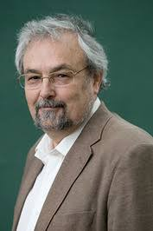
Dunbar’s number
Dunbar (1992) suggests there is a cognitive limit to the number of people with whom one can maintain stable social relationships (n=150)
The same pattern exists in online relationships (Dunbar et al., 2015)
The first three layers of social networks are usually at 5, 15, 50
Ego

Slide 8
Density
Structural property
For asymmetric networks vs. symmetric networks:
Should always be included as covariate as well
Notes:
Density is the number of connections in the network reported as a fraction of the total links possible

Slide 9
Size & Density
Nodes (n) | Possible Edges
6 | 15
12 | 66
24 | 276
48 | 1128
96 | 4560
Requires 5.5 connections to make a density of 0.1
Requires 47.5 connections to make a density of 0.1

Slide 10
Density & Communities
Density is an important parameter used to identify subgroups within the network
A community is defined by a higher density of edges within groups than between them

Slide 11
Number of Components
Many networks are composed of several components and knowing the component structure of a network is important
A “giant component” contains a large fraction of nodes
Calculate percent in the largest component

Slide 12
Reciprocity
Measures the extent to which a tie from A to B is reciprocated by a tie from B to A
Reciprocity is meaningful when a network is directed
B
A
C

Slide 13
Reciprocity (Mutuality, Symmetry)
Some relations are inherently symmetric or asymmetric
Symmetric: Who did you have lunch with?
Asymmetric: Who did you go to for advice?
Reciprocity is calculated as the percent of ties that are reciprocated:

Slide 14

Homophily
A contact between similar people occurs at a higher rate than among dissimilar people (McPherson, Smith-Lovin, & Cook, 2001)
Homophily is the principle that we tend to be similar to our friends
Birds of a feather flock together

Slide 15
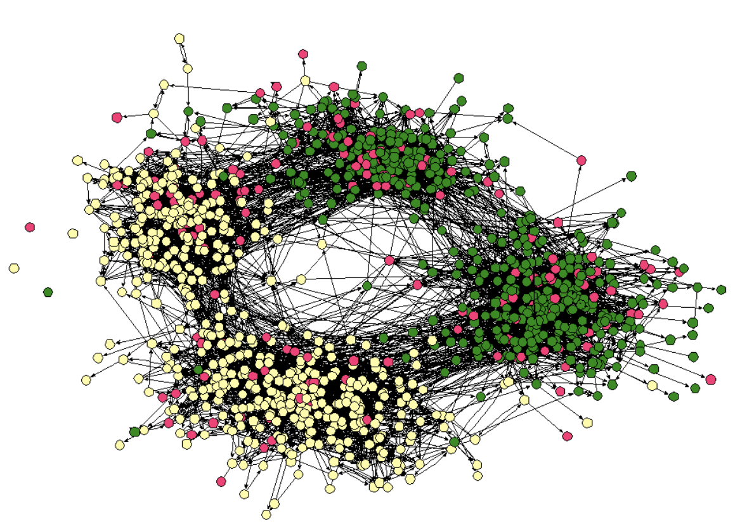
Friendship network from a town’s middle school and high school in US. Two such divisions in the network are apparent: one based on race (with students of different races drawn as differently colored circles), and the other based on friendships in the middle and high schools respectively.

Slide 16
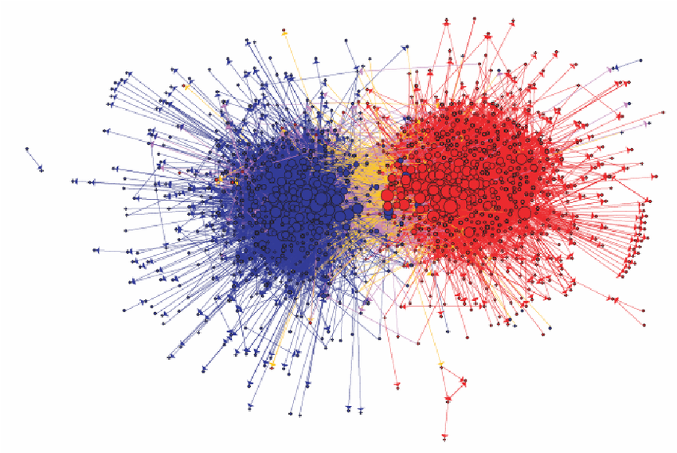
Community structure of political blogs, from Adamic and Glance (2005)

Slide 17
Two types of homophily
Status homophily : sociodemographic dimensions (race, ethnicity, sex, age, religion, education, occupation, etc)
Value homophily : internal states (political belief, attitudes, abilities, aspiration, etc)
Lazarsfeld & Merton (1954)

Slide 18
Mechanisms underlying homophily
Selection: individual characteristics drive the formation of links
Social influence: existing links in the network serve to shape people’s characteristics
Christakis & Fowler’s study on homophily & health (32 years of 12,000 people)
-> A person's chances of becoming obese increased by 57, if he or she had a friend who became obese in a given interval.

Slide 19
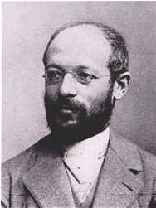
Georg Simmel (1858–1915)
One of the first sociologists to look at how the size of a group affects interactions among its members
A dyad (two member group) interactions are intense and very personal ; the least stable category of groups (e.g., marriage)
In a triad (a three member group), there may be strategies that lead to competition, alliances, or mediation
Notes:
In a larger group it would be harder to exert control on individual, but on the other hand with a large group there is a possibility of the individual becoming distant and impersonal.

Slide 20
Triads
Triad refer to any structure that involves three nodes
There are 4 types of triads with undirected
Notes:
The smallest piece of society. When a third person enters a “dyad”, it transforms into a “group” (Zimmel). ….. Heider’s “balance theory” argues that people tend to seek balance in their relations. If a triad has all positive relationship, or two negatives and one positive, it is “balanced”.

Slide 21
Transitive Triad
C
A
B
A triad is considered “transitive” when A and B both have the same relationship to C

Slide 22
Triads (cont’d)
In a directed graph there are 16 possible triads:
A→B B→C A→C
A→B B→C C→A
….
One can do a triad census of a network calculating the percent of triads of each type in the network

Slide 23
MAN (Mutual, Asymmetric, Null) Census
003
012
102
021D
021U
021C
111D
111U
030T
030C
201
120D
120U
120C
210
300

Slide 24
Social Balance Theory (Heider)
balanced
A
+
B
-
A
+
B
A
-
B
A
B
+
+
+
-
C
-
-
-
+
C
C
C
unbalanced
A
+
B
+
A
-
B
A
-
B
A
B
+
-
-
C
+
+
-
-
C
C
+
C
Notes:
The enemy of my enemy is my friend. Transitivity forms the basis of much sociological thinking about how people function in groups. Balance theory argued that people preferred a balanced environment with the people around them. Transitivity implies balance, and balance theory is one of the foundations of many behavioral theories
It is believed that people seek balance both toward others and objects (Heider)
If a person is imbalanced, this creates cognitive dissonance and people will try to reduce cognitive dissonance (Festinger)

Slide 25
Triadic closure
B
B
A
C
A
C
D
D
The Strength of Weak Ties– Granovetter (1973)
Notes:
The percent of transitive triads provides a measure of cohesion

Slide 26
Triadic Closure
If two people in a social network have a friend in common, then there is an increased likelihood that they will become friends themselves at some point in the future

Slide 27
Reciprocity & Transitivity
Networks with high levels of reciprocity:
Diffusion within faster; but
Diffusion between groups slower
Transitive triads also more likely to:
Increase homogeneity of opinions
Facilitate diffusion within groups, but inhibit diffusion of outside ideas

Slide 28
4 Nodes?
One might expect the next level of analysis to increase to 4 nodes, as reciprocity was 2 nodes, and triads 3 nodes, but
4 nodes takes us to groups

Slide 29
Diameter
Diameter: Length of the longest path in the network (the maximum distance between nodes in the network)
Networks with shorter diameters are more cohesive

Slide 30
Average Path Length (APL)
Average of all the distances between nodes
Networks with lower APL are more cohesive

Slide 31
Clustering
A measure of the degree of “clumpiness” in the network
A network with high clustering indicates that nodes are connected in dense pockets of interconnectivity, whereas one with low clustering has few pockets of interconnectivity
2 ways to measure clustering
:Average personal network density
:Percent of closed triads
Notes:
A network with high clustering indicates that nodes are connected in dense pockets of interconnectivity, whereas one with low clustering has few pockets of interconnectivity

Slide 32
Clustering: Personal Network Density (local measure)
x
x
A
y
A
y
z
z
PN Density = 1/6 = 16.7%
PN Density = 3/6 = 50.0%

Slide 33
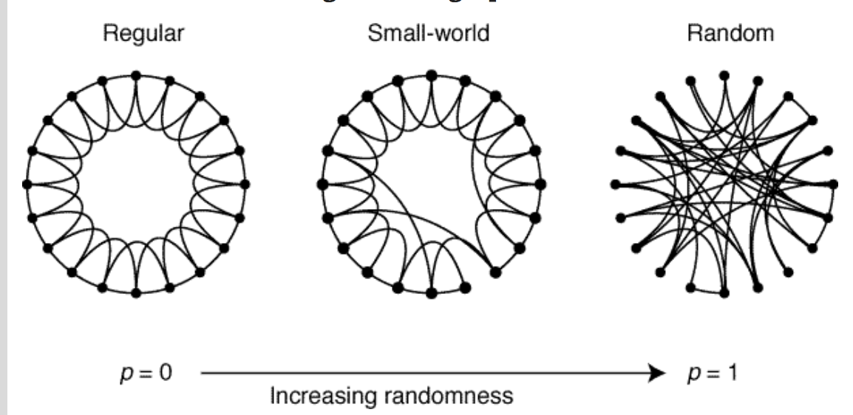
Watts & Strogatz (1998)
High clustering & Low diameter
Notes:
Watts re-introduced the clustering coefficient. Dormant for decades then revitalized by Watts & Strogatz. Characterized by: shorter path lengths than would be expected in a random network of the same size and density. Clustering can accelerate behavior and disease spread within
groups but will inhibit spread between groups.

Slide 34
Centralization
The degree ties are focused on one or a few people
Index ranges from 0 to 1 with 1 being perfectly centralized.
Recall: Centralized network are ‘scale free’ networks

Slide 35
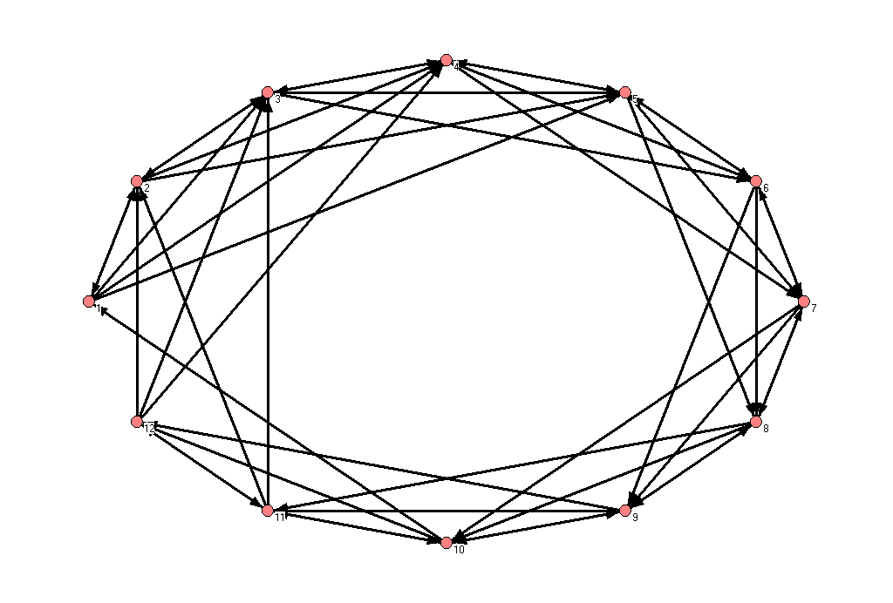
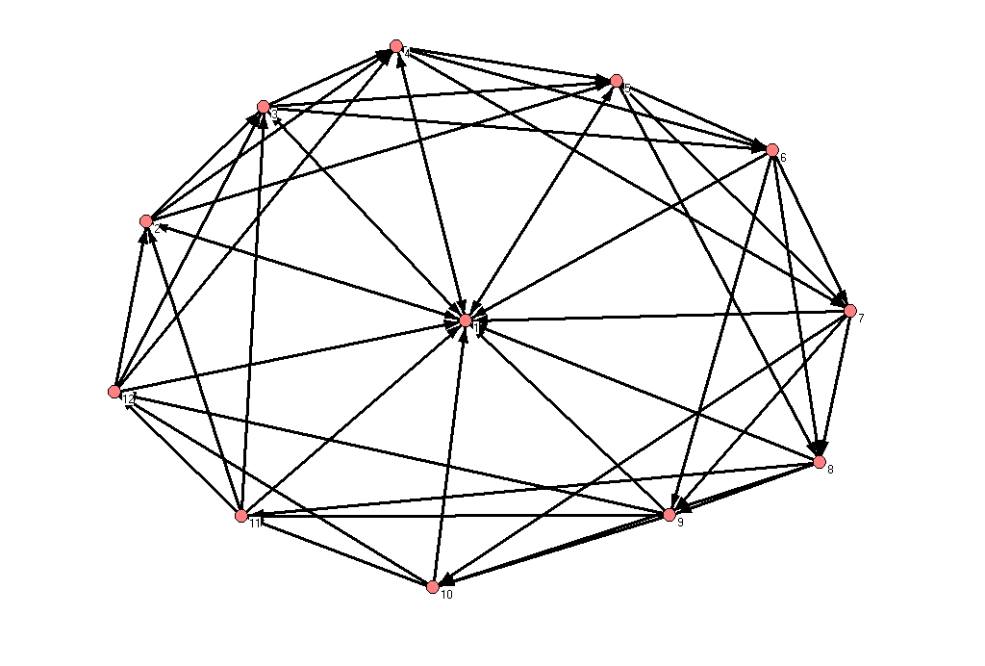
Examples of Dense Networks (Density=36.4%)
Decentralized (9.1%)
Centralized (50.9%)

Slide 36
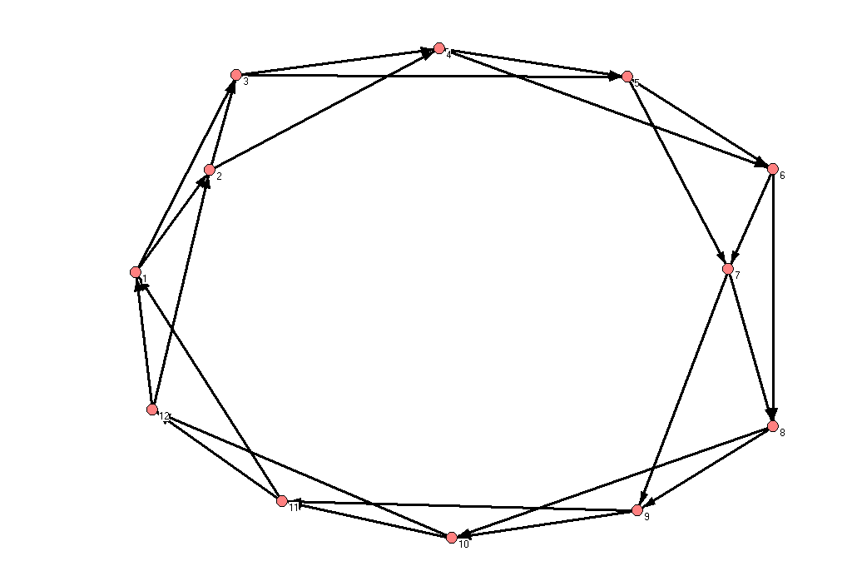
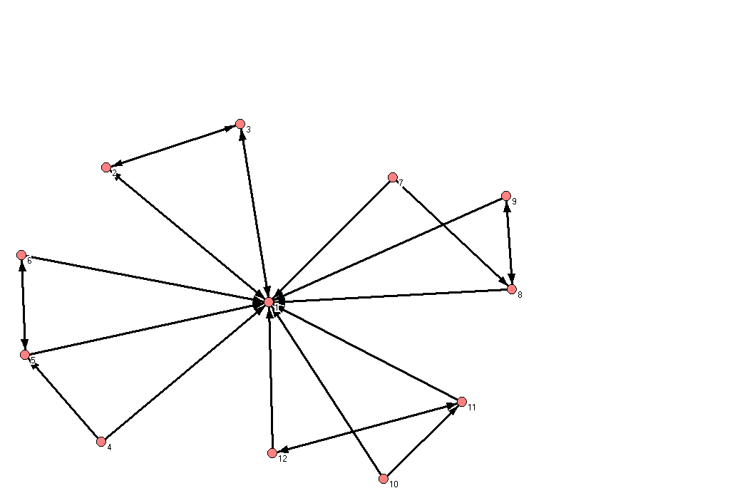
Examples of Sparse Networks
(Density=18.2%)
Decentralized (0.0%)
Centralized (87.3%)
Notes:
Thus, centralization has the net effect of placing more power and control on the central people, the opinion leaders

Slide 37
Centralization
Centralized networks should/could have fastest diffusion:
Central nodes are key players in the process
Central nodes are gatekeepers
Other properties may interact with centralization

Slide 38
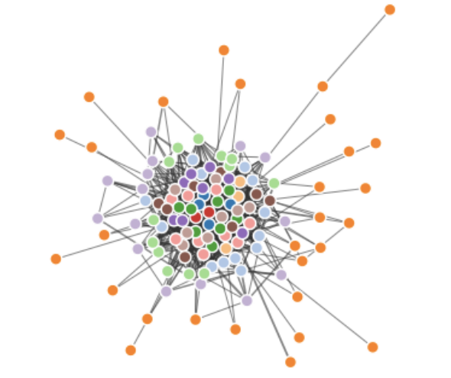
Core Periphery Structures
CP Networks have cores of densely connected people and a periphery of those loosely connected to the core and to each other
Can test whether networks have a C-P structure
Construct this idealized matrix and correlate the ideal with the empirical.

Slide 39
Core Periphery
Diffusion more likely to occur in the core
Take a while for behaviors to filter to the periphery
Many innovations may come from the periphery then percolate to the core
Core groups can keep infectious diseases endemic to communities – STDs, HIV, etc.

Slide 40
If we have more time…

Slide 41
2 Mode Data
Recall that data on events, organizations, etc. can be used to construct 2 mode networks
E.g., in this class students come from different departments
Can construct a network based on shared dept. affiliations

Slide 42
Transposing a Matrix
Matrix A
Matrix A’ (transpose)
 | Event A | Event B | Event C
Person 1 | 1 | 0 | 1
Person 2 | 1 | 1 | 0
Person 3 | 0 | 1 | 0
Person N | 0 | 0 | 1
 | Person 1 | Person 2 | Person 3 |  |  | Person N
Event A | 1 | 1 | 0 |  |  | 0
Event B | 0 | 1 | 1 |  |  | 0
Event C | 1 | 0 | 0 |  |  | 1

